Slide 1
HappyPatients Hospital
Presented By:
Mayuri Wadkar
Eric Han
Sonali Mishra
-Under Guidance of Professor Tanuja Phadke

Slide 2
Introduction
HappyPatients Hospital is a software application that allows user to manage and view Patient Data.
Users can add, delete, update and retrieve patient information in this software.

Slide 3
Technologies Used
Tomcat
Cassandra
Activemq
Memcached
AJAX
Maven
JQuery
Source code - Java
JavaScript
Jackson

Slide 4
What we had to learn from scratch
We learnt the following from scratch:
Cassandra
Activemq
Memcached
Jackson
Tomcat
AJAX

Slide 5
What we already knew
Tomcat
Java
JQuery
JavaScript
Maven

Slide 6
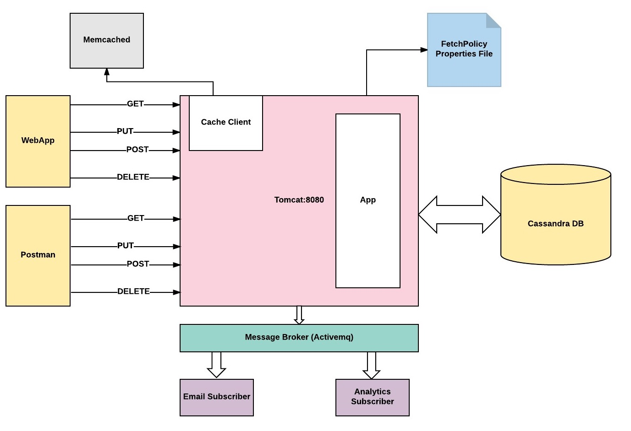
Software Architecture Diagram

Slide 7
How we set-up the environment
Install Tomcat
Install Cassandra
Install Apache ActiveMQ as a service.
Download and run Memcached.exe

Slide 8
References for learning
https://mvnrepository.com/
https://docs.datastax.com/en/developer/java-driver/3.2/
https://www.tutorialspoint.com/restful/restful_first_application.htm
https://maven.apache.org/guides/introduction/introduction-to-dependency-mechanism.html

Slide 9
Approach and Functionalities
Fields present in Patient Information:
First Name : Validation - Should be between 1-50 characters.
Last Name : Validation - Should be between 1-50 characters.
Date of Birth
Phone Number : Validation - Should be a 10 digit number. Allowed formats (111-111-1111 or 1111111111).
Address : Validation - Should be between 1-200 characters.
Status : Validation - Should be either of (ICU, Observation, Urgent Care or Discharged).
Diagnosis
Treatment

Slide 10
Approach and Functionalities
Functions we can perform on the software:
Add new patient
Update existing patient
Delete existing patient
Retrieve all patient information

Slide 11

Add new patient
User can add new patient information to the database by clicking on Make a new Patient link on the Happy Patients home page.
A screen for entering all the patient information appears.
If all the entered information is correct as per the validations, new patient record is added to the database, a unique user id is created and user is notified of successful addition.

Slide 12
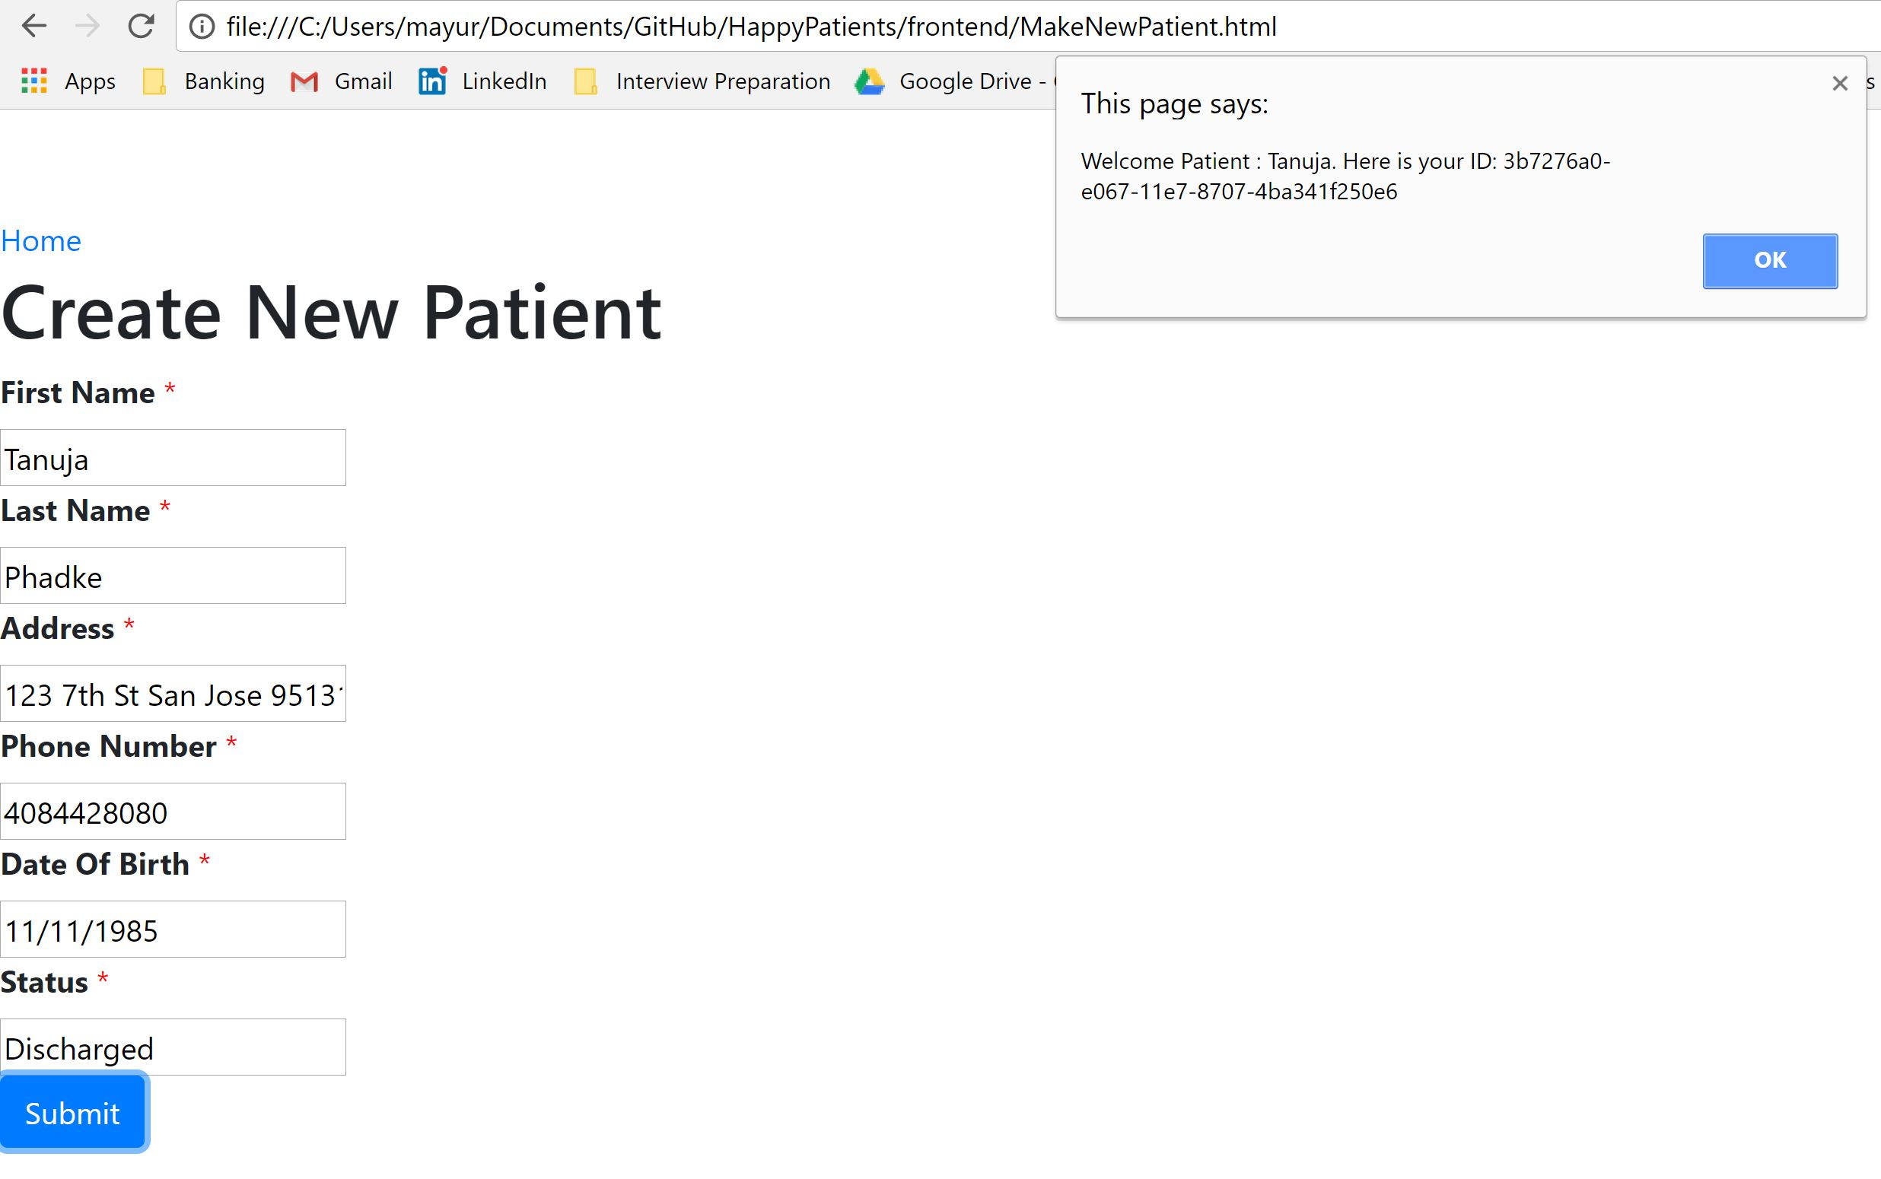

Slide 13

Update existing patient
User can update a patient’s information by clicking on Update Existing Patient link on the Happy Patients home page.
A screen for updating patient information appears.
If all the entered information is correct as per the validations, patient information is updated in the database and user is informed of successful updation.

Slide 14
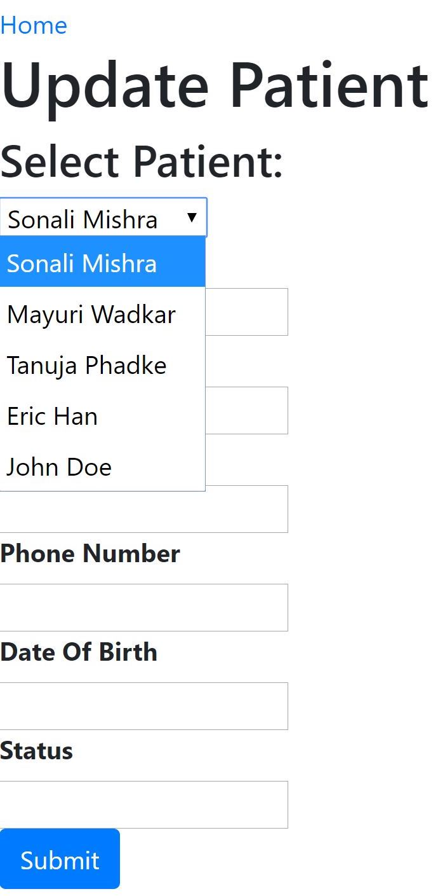

Slide 15

Delete existing patient
User can delete an existing patients record by selecting Delete Patient on Happy Patients home page.
The name of a patient can be selected from the drop-down list and Submit button has to be clicked.
User is informed of successful deletion.

Slide 16
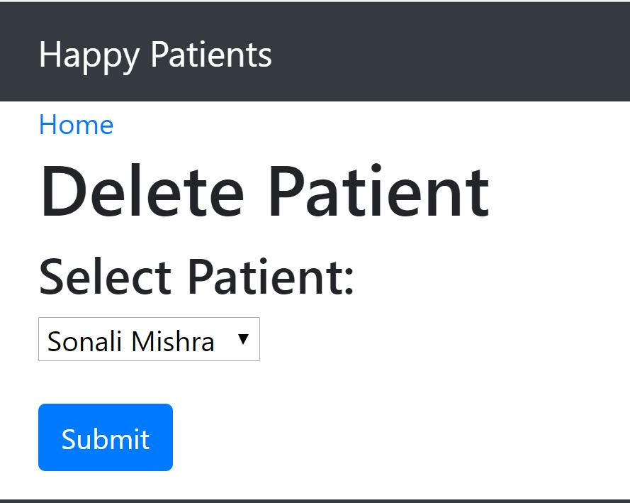

Slide 17

Retrieve all patients data
All patient’s data can be viewed by clicking View all Patients button on Happy Patient home page.
This functionality allows the user to retrieve all information in the database.

Slide 18
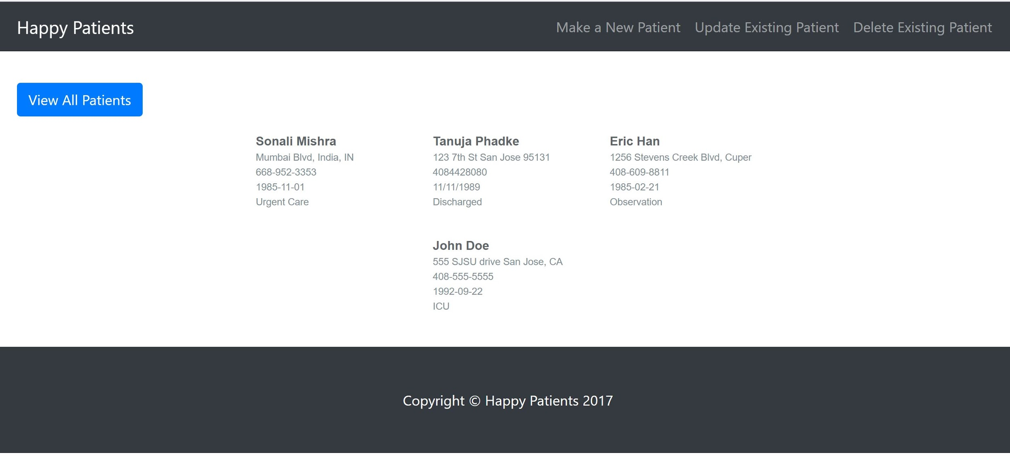

Slide 19
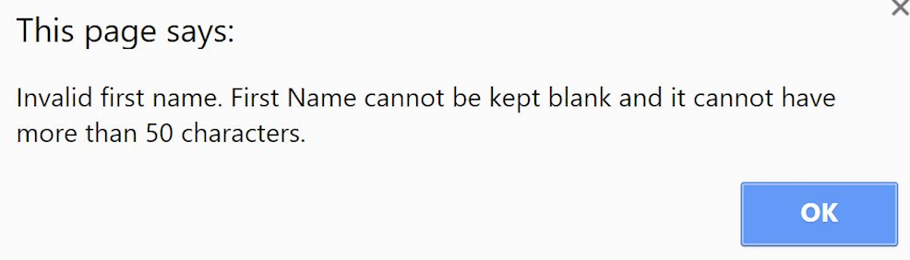
Validations
We have also added validations to each patient data field so that the database is never updated with incorrect information.
Whenever the entered information is in incorrect format, user is notified of the same.

Slide 20
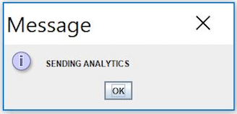
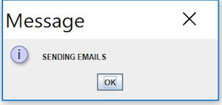
Sending Email and Sending Analytics
Whenever an or create or update operation is performed on the database, the user is notified of Sending Email and Sending Analytics using Java swing library.

Slide 21
Demo

